Slide 1
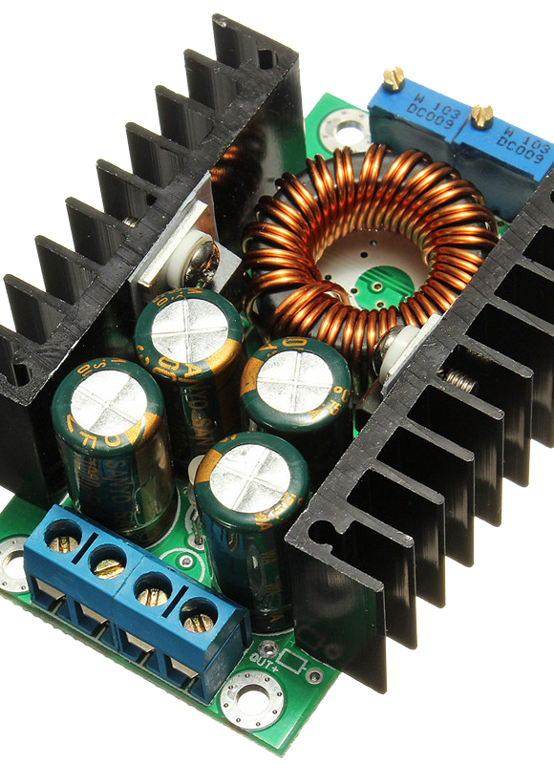
Buck Converter with feedback control System
1

Slide 2

Group Members
Name CMS ID
Ali Aqdas 285050
Abdul Hanan Gul Khan 289864
Abdur Rafae Haqqani 307327
Ali Ashraf 292926
2

Slide 3
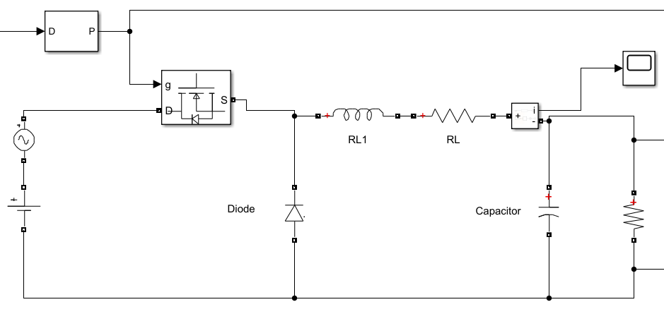
Introduction
A buck converter (step-down converter) is a DC-to-DC power converter which steps down voltage (while drawing less average current) from its input (supply) to its output (load)
3

Slide 4


Requirements
An input voltage of 28 $V$
An AC noise of 4 $V$
An output voltage of 5 $V$
An output current in the range $1−10 A$
An output ripple of $± 2\%$
An Overshoot of $20\%$ or less
$R_{on}=0.01 V$
4

Slide 5

Derivation
5

Slide 6
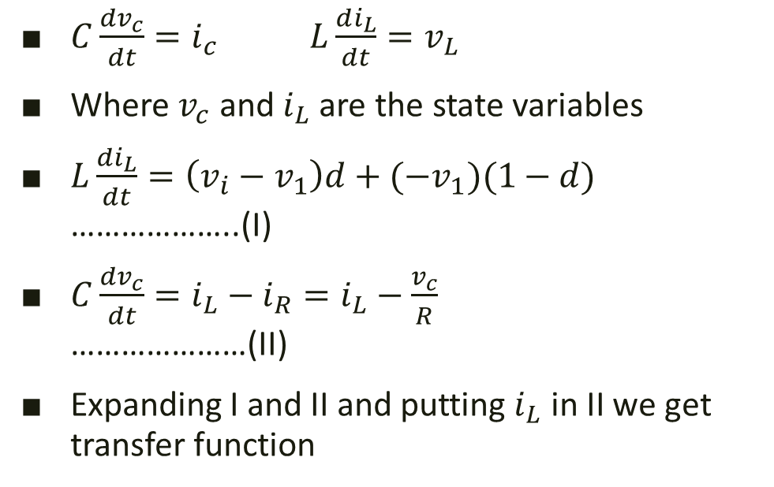
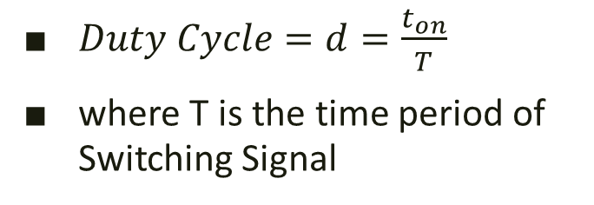
Duty Cycle
$Duty Cycle=d=\frac{t_{on}}{T}$
where T is the time period of Switching Signal
State Variables
$C\frac{dv_{c}}{dt}=i_{c}$ $L\frac{di_{L}}{dt}=v_{L}$
Where $v_{c}$ and $i_{L}$ are the state variables
$L\frac{di_{L}}{dt}=\left(v_{i}−v_{1}\right)d+(−v_{1})(1−d)$ ………………..(I)
$C\frac{dv_{c}}{dt}=i_{L}−i_{R}=i_{L}−\frac{v_{c}}{R}$ …………………(II)
Expanding I and II and putting $i_{L}$ in II we get transfer function
6

Slide 7

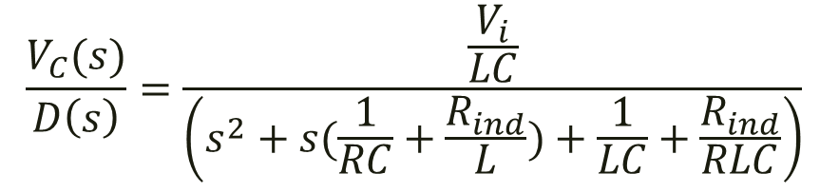
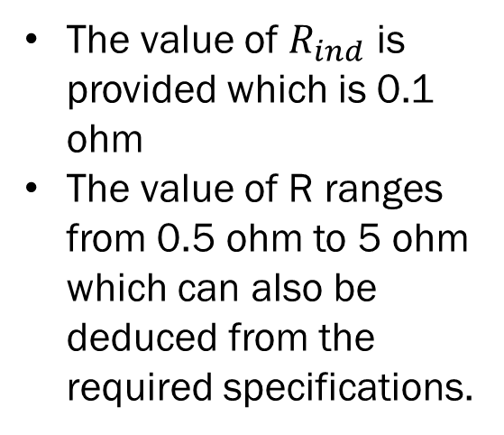
Transfer Function
$$\frac{V_{C}(s)}{D\left(s\right)}=\frac{\frac{V_{i}}{LC}}{\left(s^{2}+s(\frac{1}{RC}+\frac{R_{ind}}{L})+\frac{1}{LC}+\frac{R_{ind}}{RLC}\right)}$$
Value of L and C
R and $R_{ind}$
Where we select L as 3mH, and we select C as 22uF as they are easily available
The value of $R_{ind}$ is provided which is 0.1 ohm
The value of R ranges from 0.5 ohm to 5 ohm which can also be deduced from the required specifications.
7

Slide 8
Bode plot and root locus
8

Slide 9
Frequency Determination
Ripple voltage requirement= 2% of 5 volt= 0.1v
Gain is lower at smaller loads
Frequency determined at minimum load i.e. 5 ohm
Requirement met at 10 kHz frequency.
Corresponded to -20db gain
Lesser gain for higher loads.
9

Slide 10
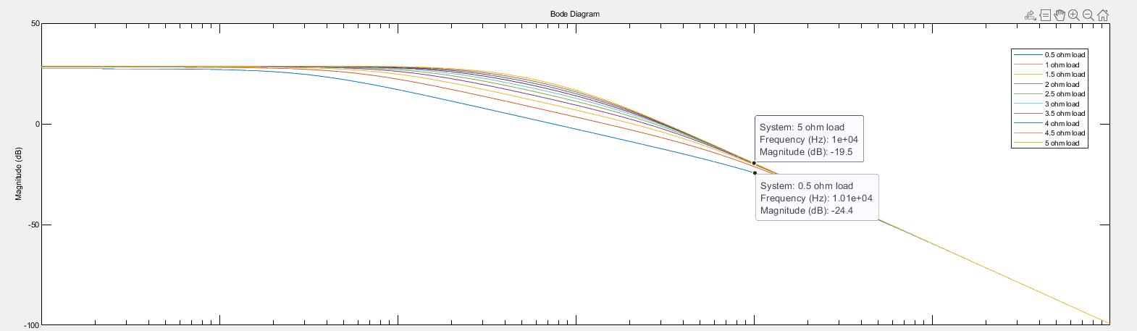
10

Slide 11
Root Locus
Overshoot < 20 %
Required for finding gain value for PI controller.
Overshoot maximum at minimum load i.e. 5 ohm.
Gain was found for overshoot at 5 ohms load.
11

Slide 12
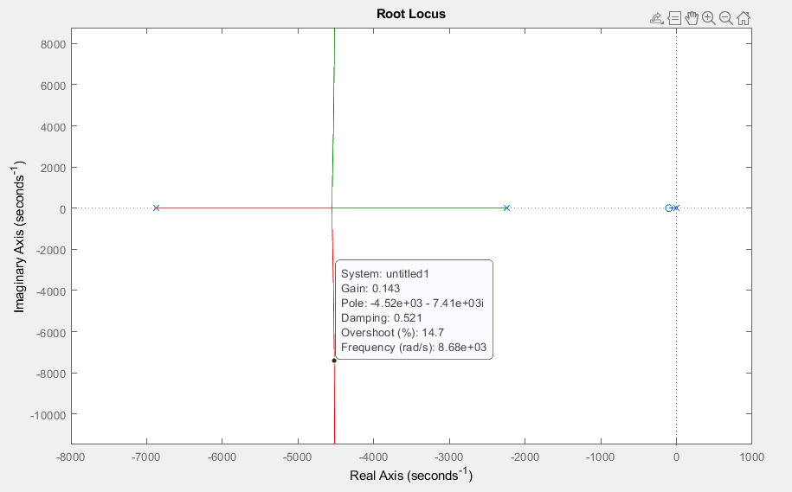
12

Slide 13
Code
13

Slide 14
Feedback Control
How and Why?
14

Slide 15




General Feedback System
$$V_{desired}(s)$$
Compensator
Plant
$$V_{out}(s)$$
$$+$$
$$−$$
15

Slide 16
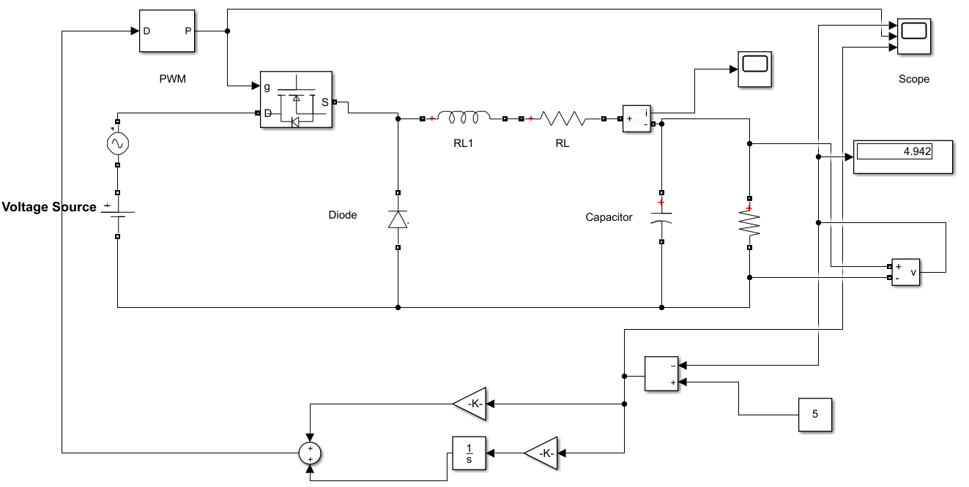
16

Slide 17
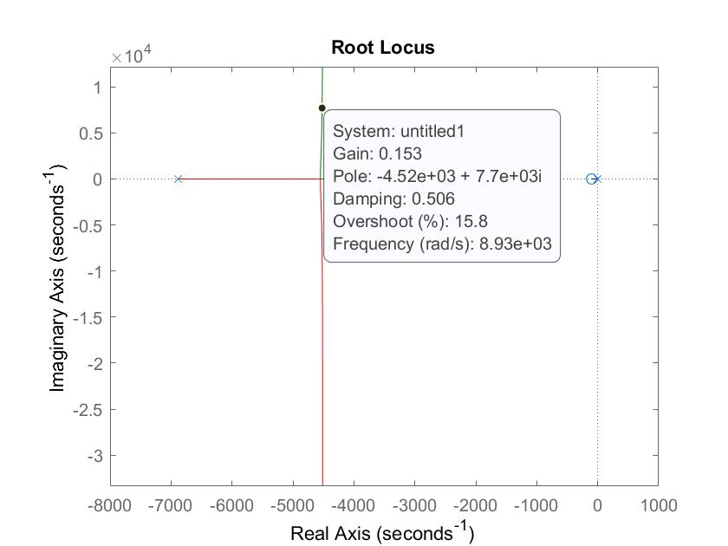

Why PI Controller?
We have used a PI Controller to reduce steady-state error.
We found $K_{p}$ using root locus with compensating system attached. $K_{i}$ is set a higher value to reduce settling time without differentiation
17

Slide 18
Output Waveforms
18

Slide 19
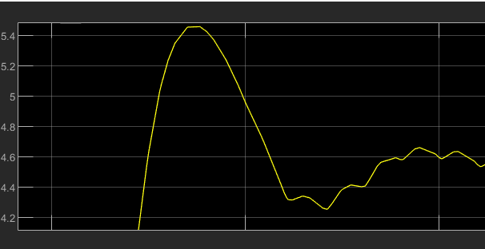
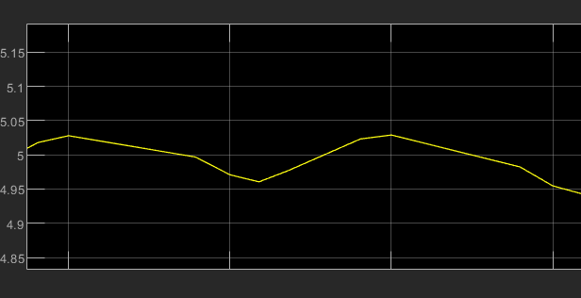
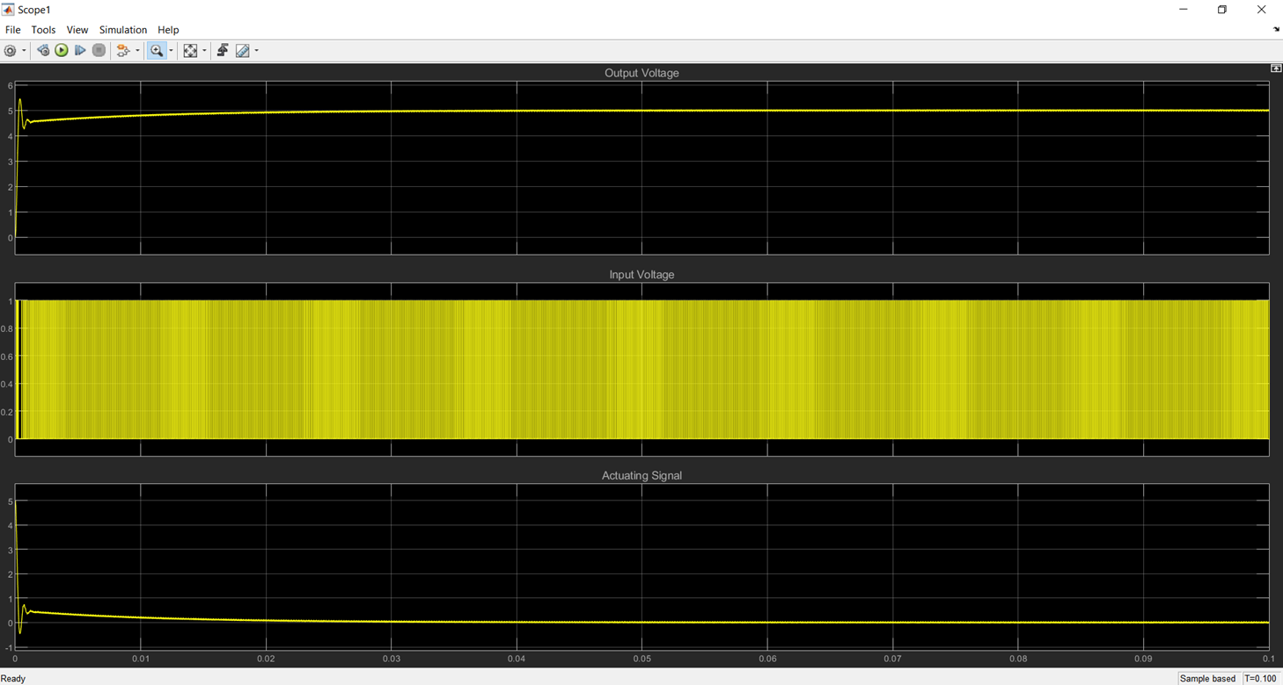
Waveform (5 Ω load)
Noticeable overshoot, still within specifications.
Negligible steady state error.
Ripple in steady state within specifications.
19

Slide 20
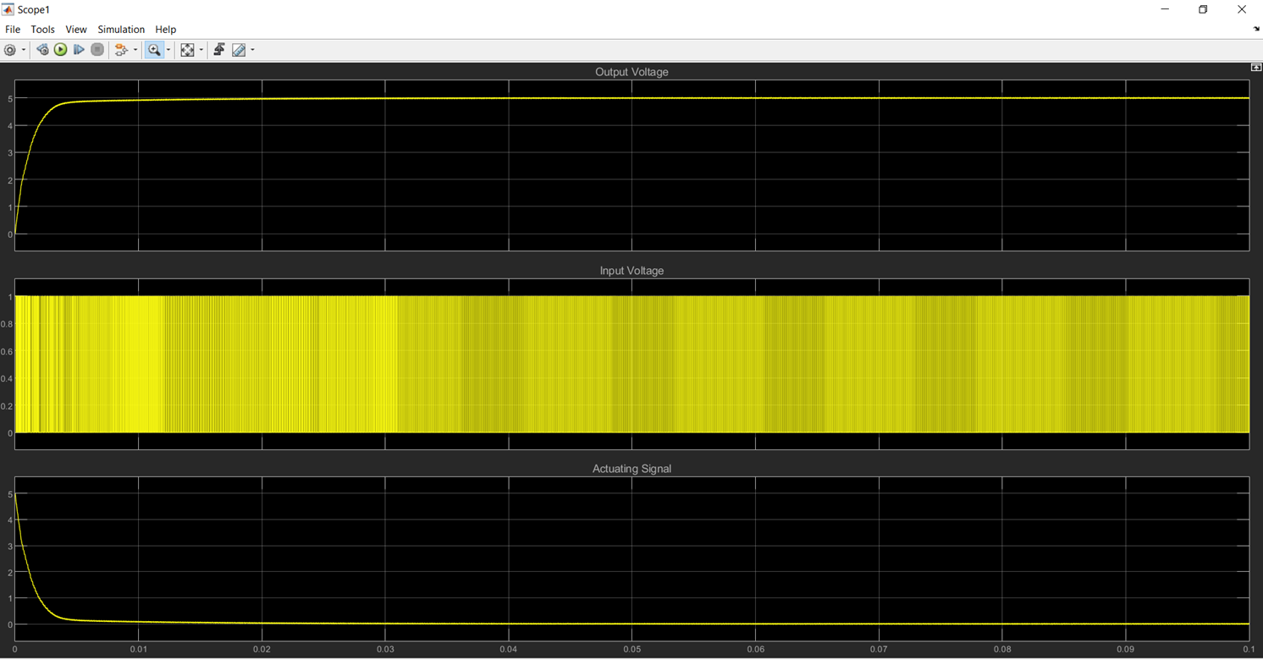
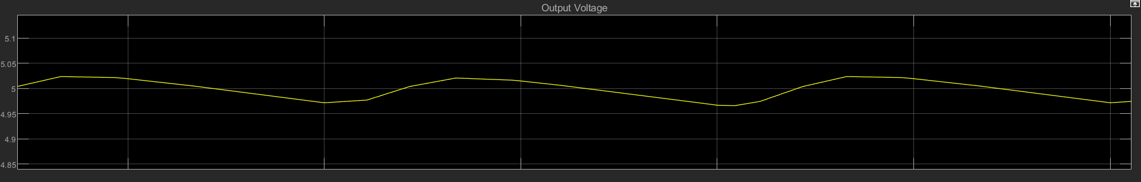
Waveform (0.5 Ω load)
No overshoot, specifications exceeded.
Negligible steady state error.
Ripple in steady state still within specifications.
20

Slide 21
Cost estimation
14

Slide 22
Components | Cost
3mH 10A Toroidal Inductor | 160 PKR
22 uF 16 Volt Tantalum Capacitor | 119 PKR
IRF9540 Power MOSFET, Maximum Operating Frequency > 1MHz | 60 PKR
Diode 1N4007 | 1 PKR
Arduino Nano | 1750 PKR
2 Wire 0.28 Inch mini-DC voltmeter | 170 PKR
Total Cost | 2260 PKR

Slide 23

Any Questions??
21

Slide 24
Thank You
22

